Slide 1
Governing Our Future:
The Fawzooz AI Management System
(AIMS)
A Strategic Framework for Trustworthy AI in Mental Wellness

Slide 2



The Strategic Imperative: Why This, Why Now?
Complex Regulatory Landscape
Trust is Our License to Operate
Responsible AI is a Competitive Advantage
Navigating HIPAA, GDPR, and UAE's data localization laws is a condition of market access. Non-compliance carries severe financial and legal penalties.
In mental wellness, user trust is not a feature; it's our entire business model. A single ethical or safety failure could be catastrophic.
The market leader will be the one who masters responsible innovation. A robust governance framework enables us to move faster, safely.
Notes:
"Good morning. We are at a pivotal moment. The AI we are building has the power to transform mental wellness, but our success is not guaranteed by technology alone. Our success will be determined by trust. We operate in a minefield of regulations, and our users' sensitivity to privacy and safety is at an all-time high. This presentation is about our strategic response: a formal AI Management System, or AIMS, that turns this complex risk landscape into our greatest competitive advantage."

Slide 3
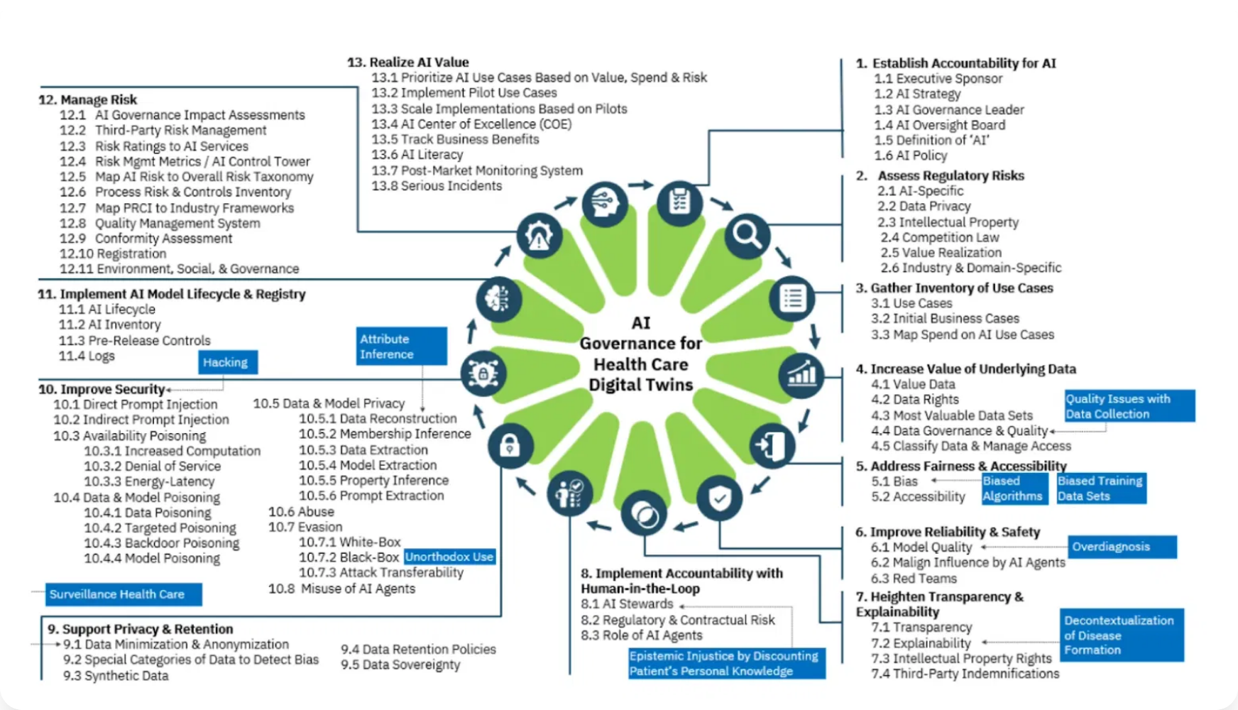

Slide 4
Our Solution: The AI Management System (AIMS)
A systematic framework to direct and control all AI activities
Based on Global Best Practice
Aligned with the international standard, ISO 42001.
Holistic & Integrated
It's not just an IT system. It governs our policies, our processes, our people, and our technology.
Mission-Driven
Designed specifically to uphold our commitment to safe, ethical, and effective AI for mental wellness.
Notes:
"Our solution is to move from ad-hoc good intentions to a systematic, auditable framework. We have built our AIMS based on the global gold standard, ISO 42001. This isn't just a binder on a shelf; it's an operational system that integrates our ethical principles directly into our product lifecycle."

Slide 5
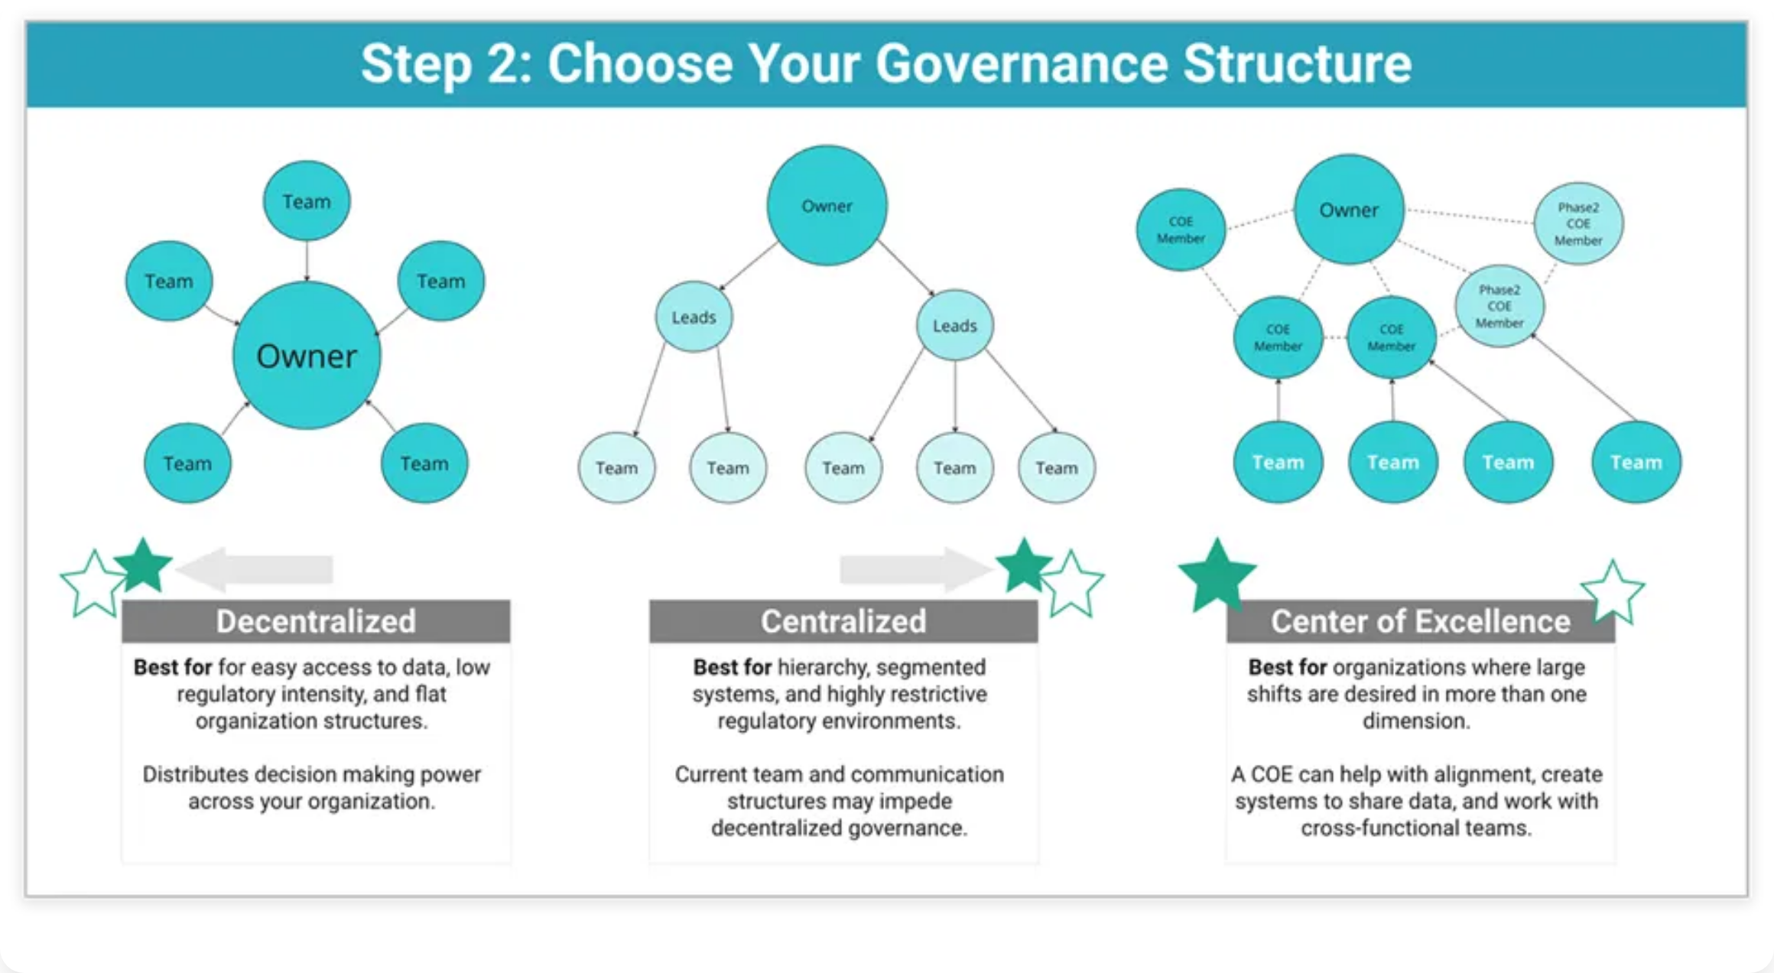

Slide 6






Our Guiding Principles: The AI Policy
Our AIMS is built on six non-negotiable principles:
Beneficence & Non-maleficence
Patient Autonomy
Fairness & Equity
Do good, do no harm. Our AI systems must be designed to benefit users and actively prevent potential harms.
Empower users with choice and informed consent. Users must maintain control over their data and interactions.
Actively fight bias. Our systems must work equally well for all users regardless of background or identity.
Transparency & Explainability
Privacy & Security
Accountability & Human Oversight
Be open about how our AI works. Users deserve to understand the systems they interact with and how decisions are made.
Protect data as if it were our own. Mental health data requires the highest standards of security and confidentiality.
Humans are always accountable. AI systems must be designed with appropriate human oversight and clear lines of responsibility.
Notes:
"These six principles, enshrined in our formal AI Policy, are our north star. They are the ethical criteria against which every AI project is measured. Crucially, our AIMS ensures these principles are not just ideals, but are enforced through concrete operational controls."

Slide 7
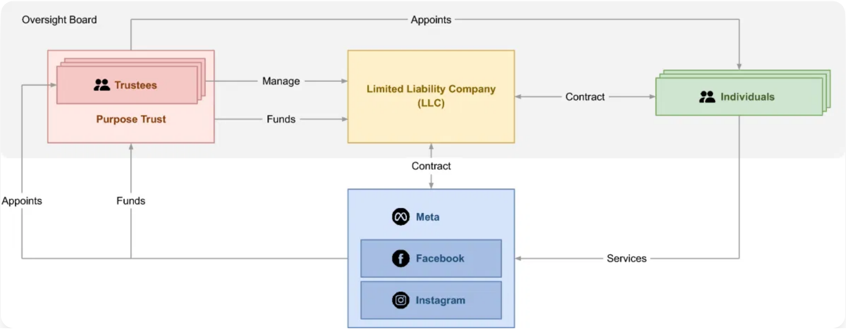

Slide 8
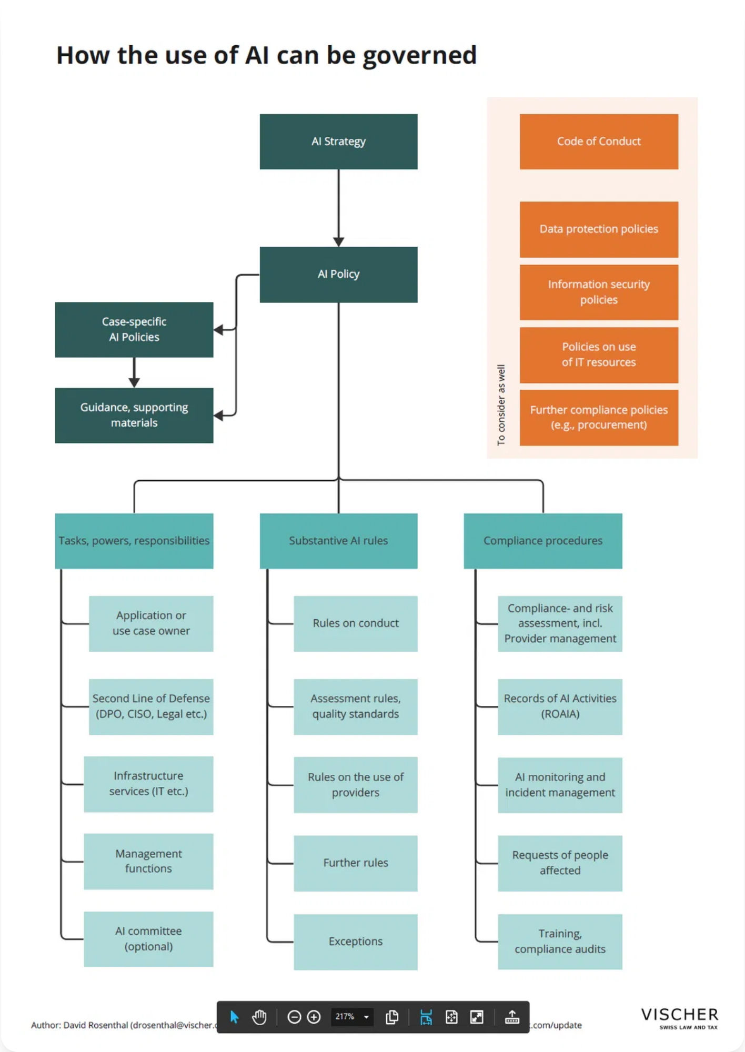
How We Govern: Structure & Accountability
Clear ownership and cross-functional oversight are key
AI Governance Committee (AIGC)
The central steering body, chaired by the CISO, with members from Legal, Ethics, Clinical, and Technology. It provides strategic direction and approves high-risk projects.
Clear Roles
We have defined clear "owners" for the AIMS (CISO), for ethics (CAIO), and for every AI system (Product Managers).
Accountability is Documented
Our RACI matrix ensures there is no ambiguity about who is responsible, especially in a crisis.
Notes:
"To make this work, we've established a clear governance structure. The AIGC is the engine room, ensuring that decisions about AI are not made in a silo but with a 360-degree view of risk and responsibility. We have clearly defined who is accountable for every aspect of the AIMS, which is critical for effective management and rapid response."

Slide 9
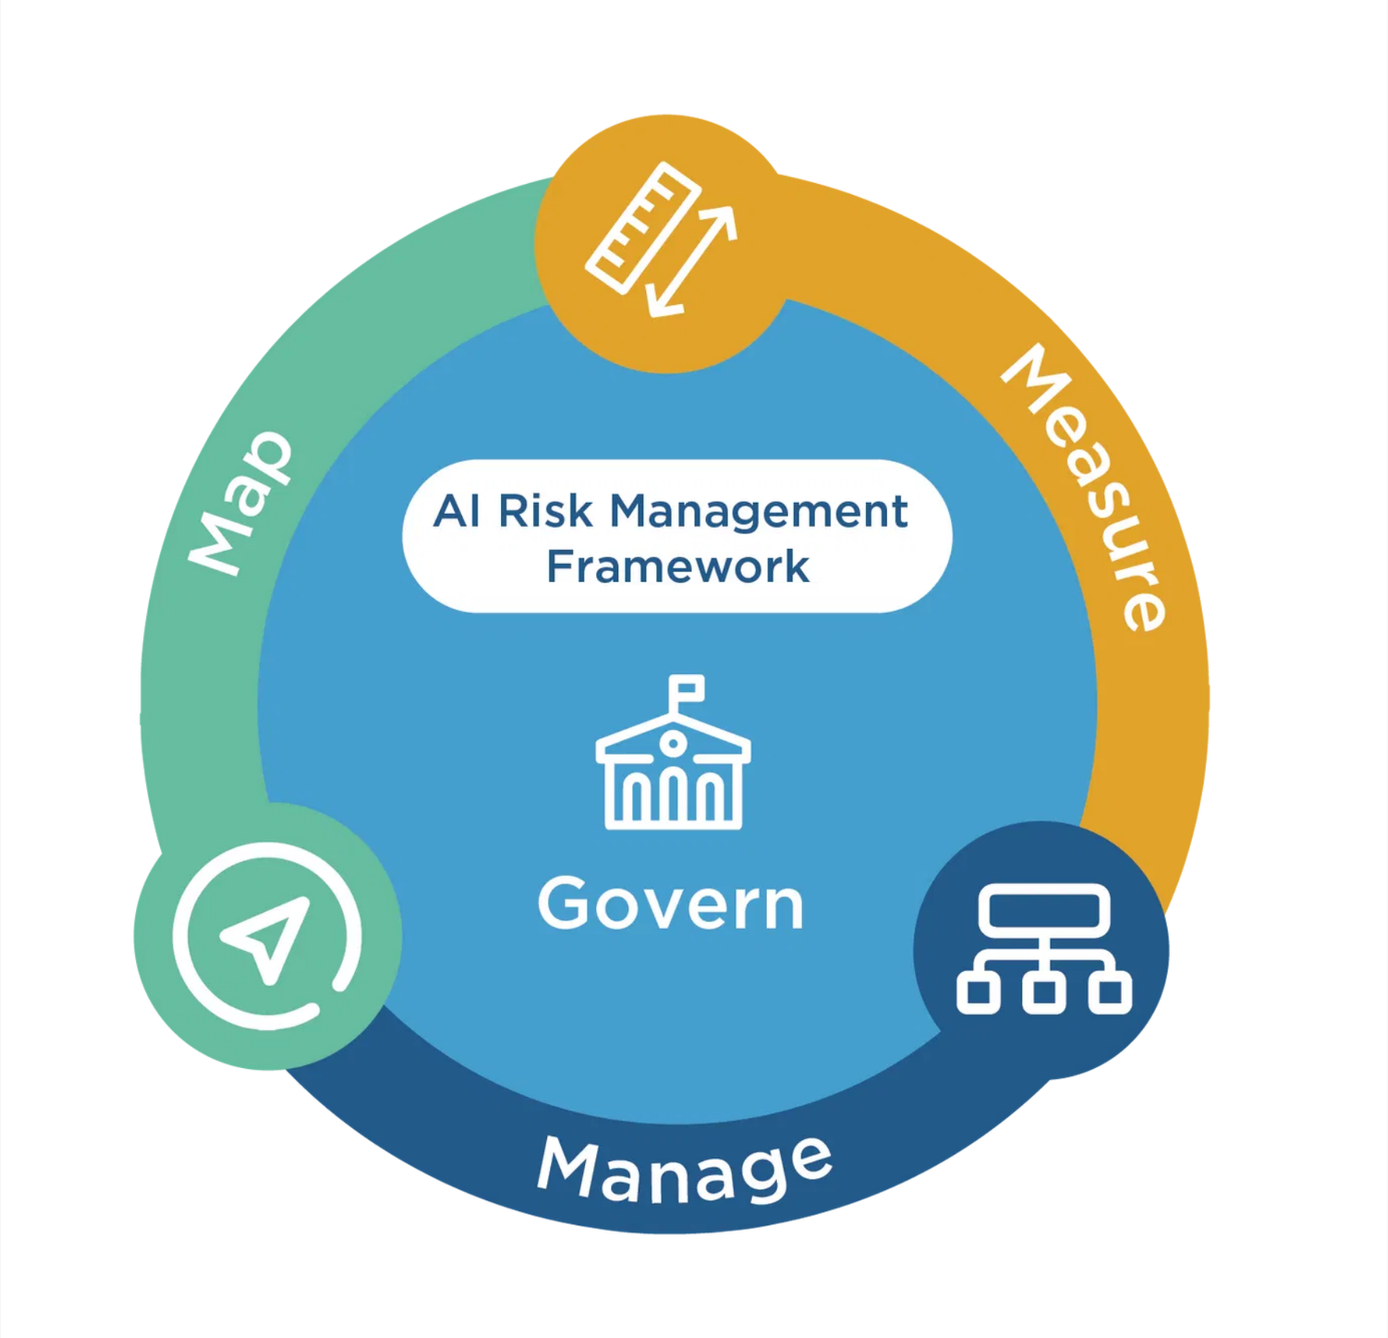
Proactively Managing Our Unique Risks
Our risk assessment process is tailored for the unique challenges of mental wellness
Risk Categories
Clinical Safety
Ethical & Bias
Privacy & Security
Beyond Technical Risks
We formally assess for Clinical Safety Risks, Ethical & Bias Risks, and Privacy Risks.
Prioritizing Human Impact
Our risk matrix explicitly prioritizes risks that could cause psychological distress or erode user trust.
A Living Process
Risk assessments are mandatory for all new projects and major changes, ensuring governance keeps pace with innovation.
Notes:
"A standard IT risk assessment is not sufficient for what we do. A system failure for us isn't downtime; it's a potential clinical crisis. That's why our risk assessment process is uniquely adapted to our domain, forcing us to prioritize and mitigate the risks that matter most—those that impact the well-being of our users."

Slide 10
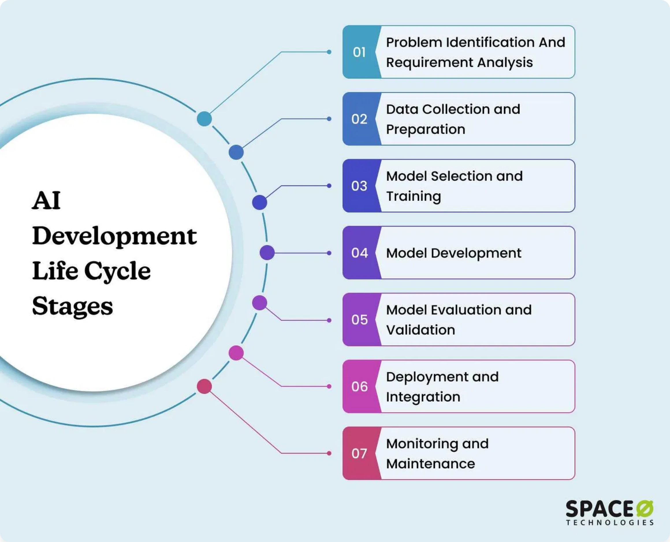





Responsibility Embedded: The AI Lifecycle
Plan
Ethics Review
Mandatory ethics review at the design phase ensures alignment with our principles.
Develop
Safety Check
Development practices include built-in safeguards and ethical constraints.
Validate
AIGC Approval
Rigorous testing for fairness, safety, and security before deployment.
Deploy
Final Sign-off
Human oversight designed in from the start with clear accountability.
Monitor
Ongoing Review
Continuous monitoring for performance and bias in production.
We build responsibility in, not bolt it on.
Notes:
"Our AI SDLC operationalizes our principles. It embeds mandatory safety and ethics checkpoints at every stage of development. This means we identify and fix problems early, before they can ever reach a user. This 'responsibility-by-design' approach is fundamental to our ability to innovate safely."

Slide 11





Our Safety Net: The Crisis Intervention Protocol
A prime example of our commitment to safety in action
Crisis Intervention Flow
1
The AI's Role
Our suicide risk detection AI acts only as an early warning and triage tool.
AI Detects Risk
AUTOMATIC ALERT
2
The Protocol
When the AI flags a high-risk user, it automatically triggers an alert and disengages.
Human Clinician Takes Over
3
The Human Handoff
The interaction is seamlessly transferred to our 24/7 team of licensed human clinicians who take over, ensuring a qualified professional manages the crisis.
Notes:
"This is perhaps the single most important operational control we have. It perfectly illustrates our philosophy. We use AI for what it's good at—detecting patterns in data at scale. But in the most critical moments, we ensure a trained, empathetic human is in control. This protocol is our ultimate safety net."

Slide 12
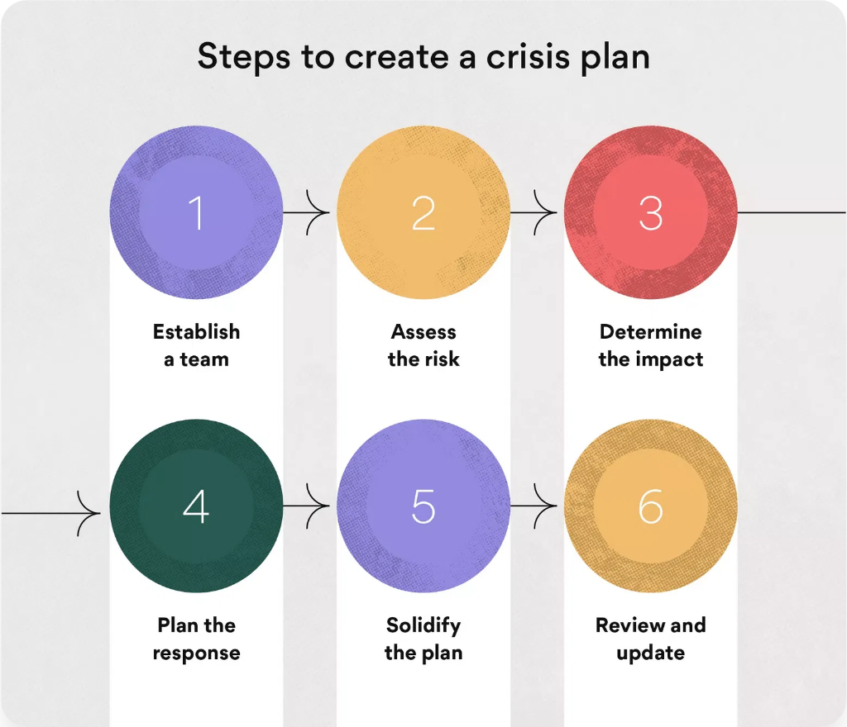

Slide 13
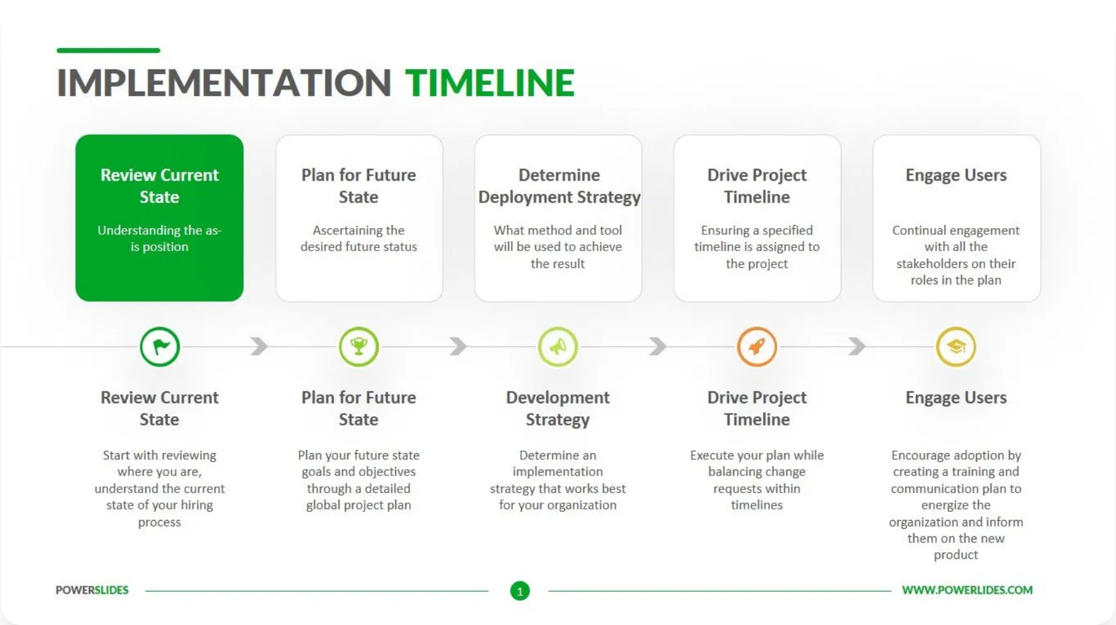
The Path Forward: Implementation Roadmap
A phased, manageable approach to full implementation over the next 6-9 months
1
Foundation & Mobilization
Finalize policies, formalize the AIGC, establish governance structure.
2
Rollout & Deployment
Conduct training, deploy core processes like risk management and ethics review.
3
Operational Integration
Embed AIMS into all new and existing projects, implement monitoring systems.
4
Continual Improvement
Launch internal audit program and prepare for external ISO 42001 certification.
Phase 1
Phase 2
Phase 3
Phase 4
Months 1-2
Months 3-4
Months 5-7
Months 8-9
Notes:
"We have a clear, realistic plan to make this AIMS fully operational. This phased roadmap ensures we can implement these changes effectively without disrupting business operations. Our goal is to be ready for an external ISO 42001 certification audit within a year."

Slide 14
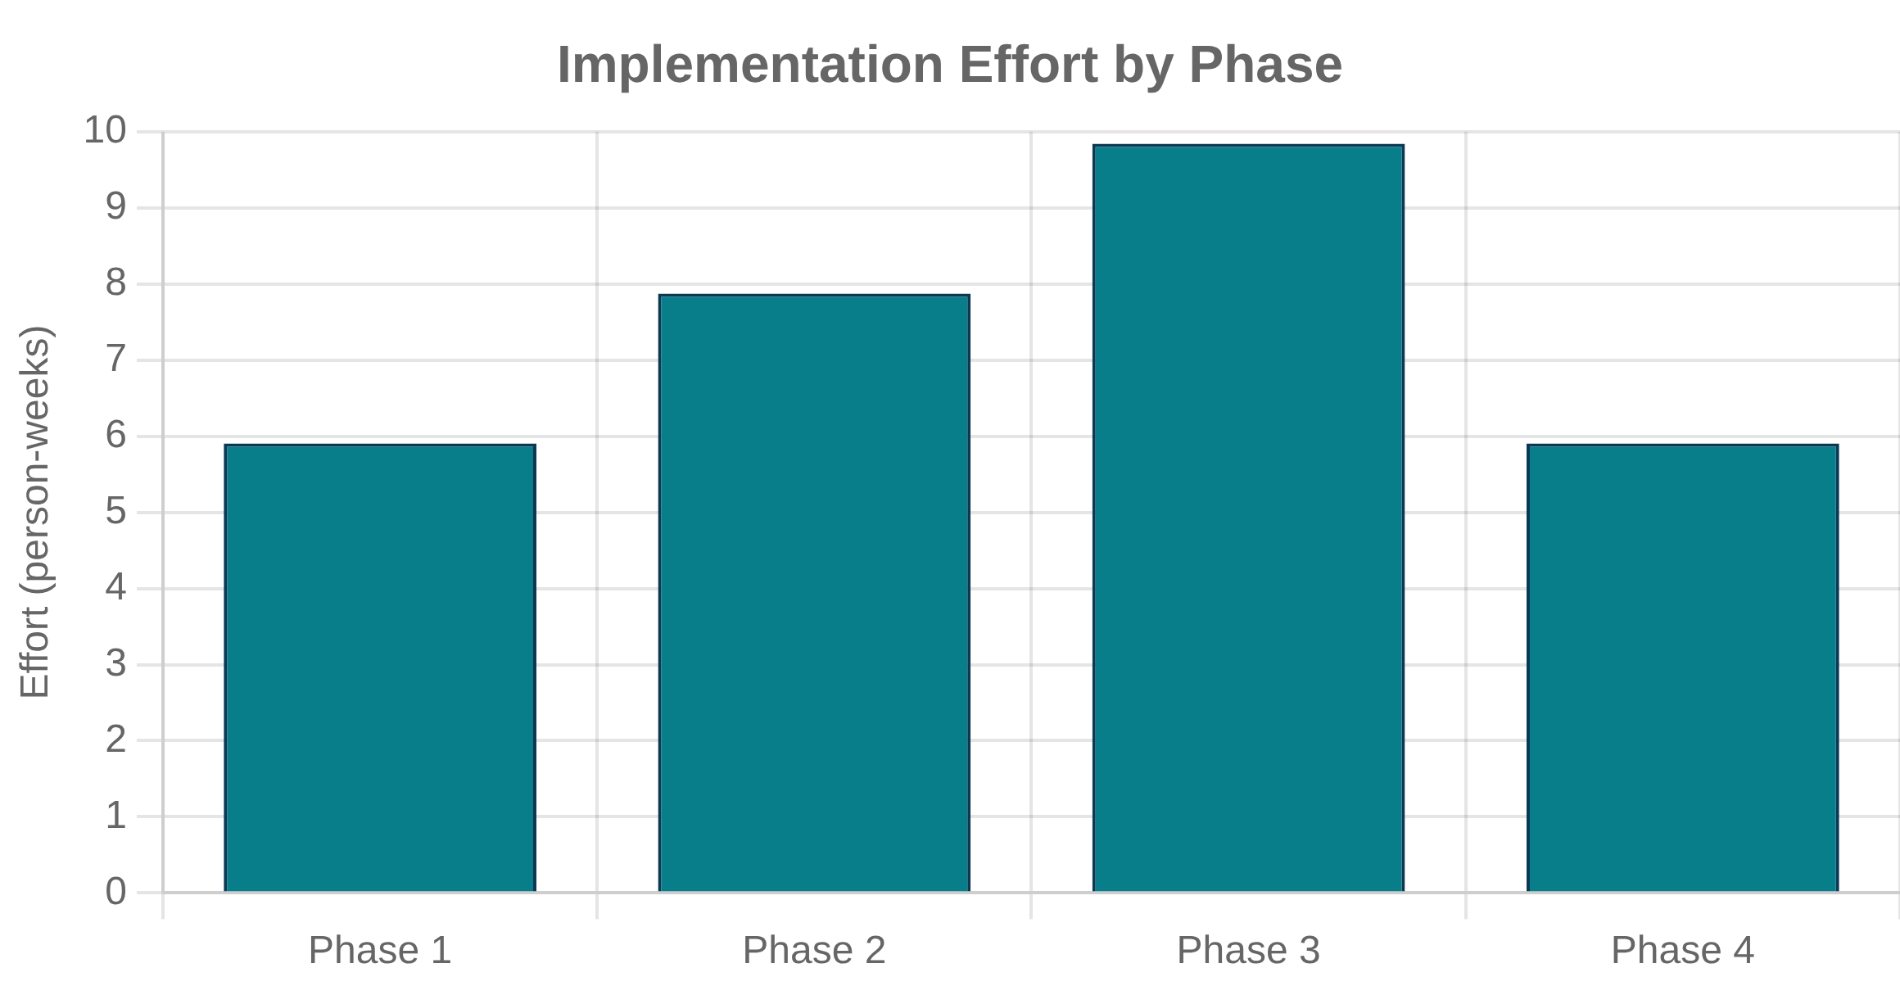

Slide 15
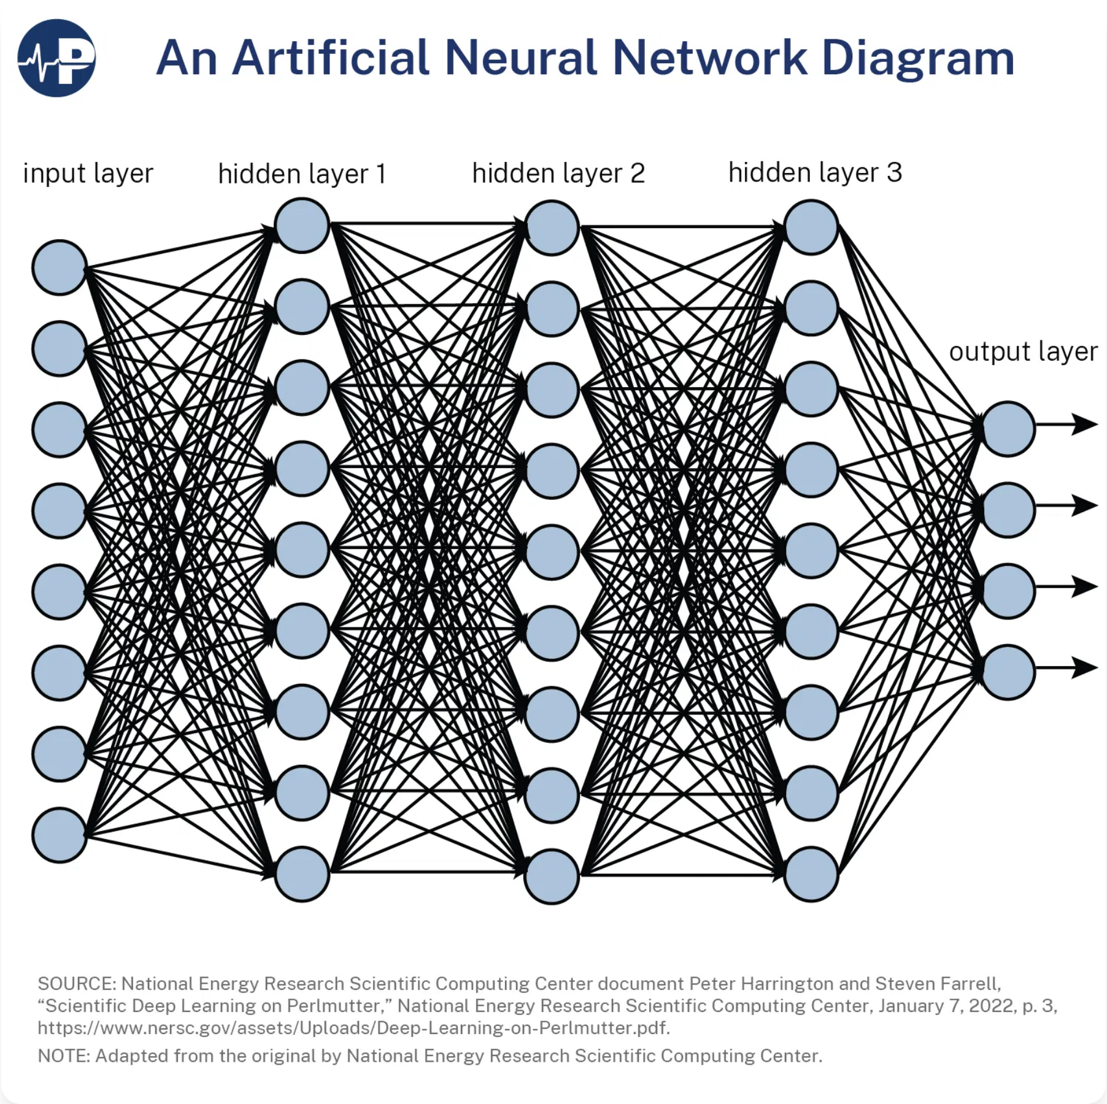



Conclusion: A Framework for Trust & Growth
Implementing the AIMS will:
Build Unbreakable Trust
Create a foundation of trust with our users and clinicians.
Mitigate Significant Risk
Protect against legal, reputational, and clinical risks.
Provide a Defensible Framework
Demonstrate to regulators our commitment to responsible AI.
Unlock Innovation
Give our teams a safe framework to build within.
Call to Action:
Formal approval of the AIMS policies and charter
Fawzooz AI
Endorsement of the implementation roadmap
Building the future of mental wellness

